Slide 1
ICS Health and Care Strategy for North West London
Health & Wellbeing Board - Harrow
22nd June 2023

Slide 2
Cover note
In common with all Integrated Care Systems, North West London Integrated Care System is required to produce a strategy
The strategy must cover both health and care (i.e., health and relevant local authority services)
The NHS and local authorities are required to ‘have regard’ to the strategy
The strategy has been prepared for, and must be adopted by, the North West London’s Integrated Care Partnership. The Partnership brings together local authorities and the NHS across our eight boroughs
The strategy has taken, as its starting point, the Joint Strategic Needs Assessments and Joint Health and Wellbeing Strategies developed for each borough, and incorporated resident insights
The strategy aims to highlight where boroughs and the NHS can go further, faster for our residents by working together. It does not attempt to collate everything that each partner in the ICS is doing. For example, the ‘shared outcomes’ reflect the judgment of the DPHs of the outcomes that could be improved faster by working together
It is structured around the ICS’ programmes, which are the delivery vehicles for the strategy. It informs the one year delivery plans of all the ICS programmes. Priorities for the programmes are then grouped into six cross cutting themes
The draft strategy was published on 21st May. The Health and Wellbeing Board is asked to challenge and comment on the strategy – in particular, what areas members of the HWB believe should be emphasised, amended or removed
Input from all HWBs, alongside input from our residents, will then be synthesised into the next draft of the strategy.

Slide 3
Strategy engagement – we want to hear from you
Hearing from a wide range of voices throughout communities who will feel the impact of the delivery of the top priorities in health and care services in North West London helps ensure this strategy fits the needs of residents. We want to make sure that resident insight is embedded into the heart of this draft strategy. Insights captured includes the ‘what matters to you’ outreach, borough collaborative spaces and insight from local authority, Healthwatch and voluntary & community sector colleagues.
Joining up with local authority engagement on Health and Wellbeing Strategies
NW London Residents Forum, open to all with an anticipated 200 attendees
Citizen Panel with access to 3.8k members
Next Door insights

Slide 4
Strategy development – why we need a health and care strategy
As we launch the ICS, we have the opportunity to set an exciting vision and strategy for North West London that builds on our achievements to date, and takes advantage of our strengthening collaboration across health and care to improve outcomes for our residents and communities, address long standing inequalities in access, experience and outcomes, level up, improve value for money and deliver wider benefits across North West London.
Four objectives of integrated care systems
Improve outcomes in population health and wellbeing
A
Prevent ill health and tackle inequalities in outcomes, experience and access
B
C
Enhance productivity and value for money
D
Support broader economic and social development

Slide 5
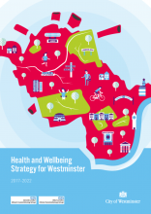
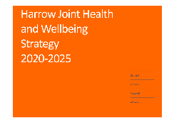
Strategy development – how we have built on what has gone before using resident insight
Joint Strategic Needs Assessment
Context and needs of NW London
Case for change
Involvement and insights
Health and Wellbeing Strategies
Shared outcomes
Delivery
Networks
Enablers
Proactive population health & inequalities
Local care
Mental health, learning disabilities & autism
Acute care
Cancer
Maternity
Children & young people
Involvement & Community
Data & Digital
Workforce
Finance & Estates
Research & Innovation
Programme and Networks
Plans
Actions

Slide 6
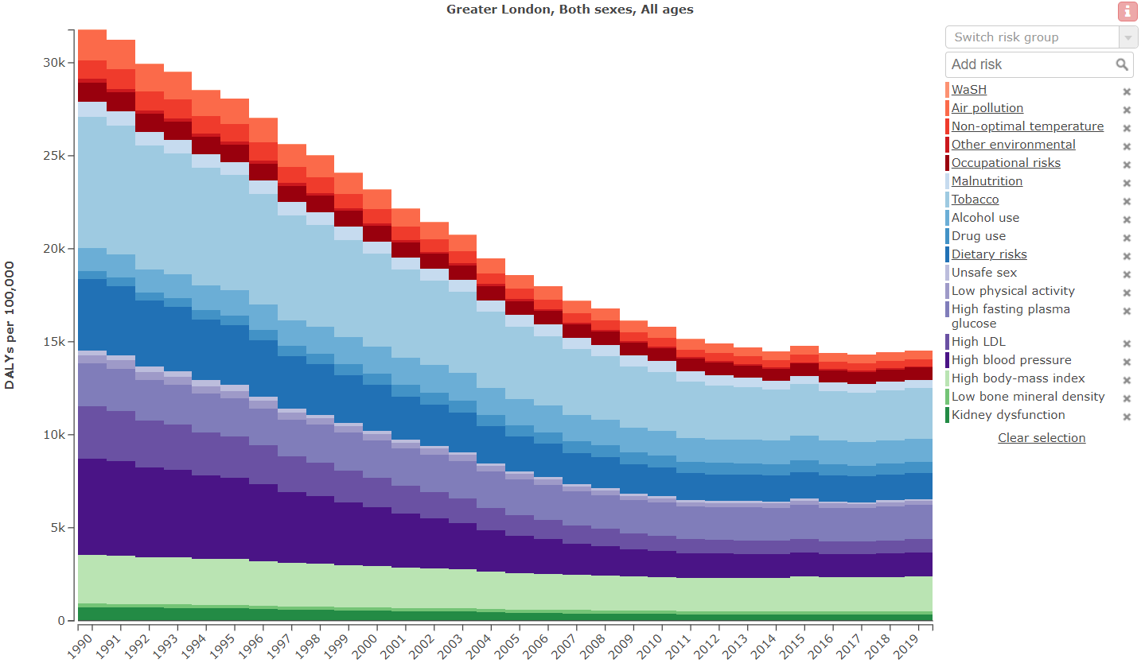
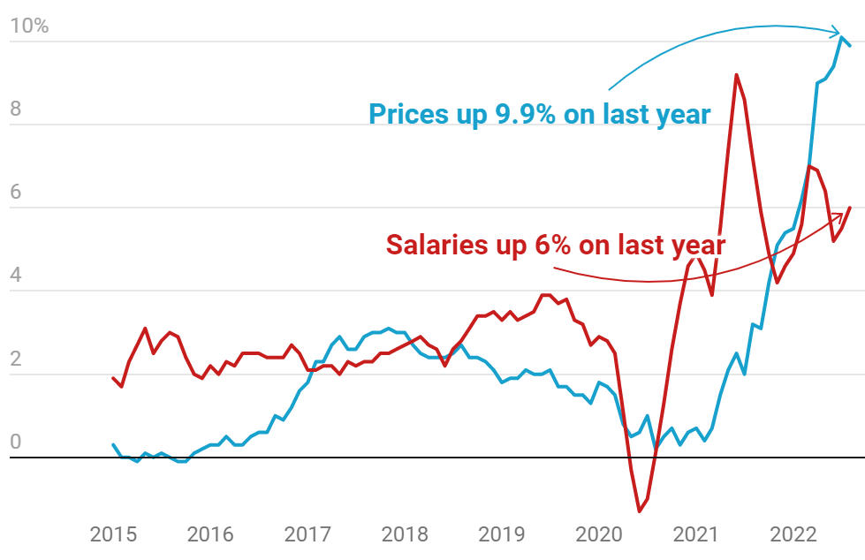
Challenges – areas of concern for NW London
Improvement in health status have appeared to stall, we have an almost record number of people on out of work benefits and the cost of living crisis continues
DALYs per 100,000 population
Inflation vs income
Source: GBD Compare tool, HBAI Stat-Xplore)

Slide 7
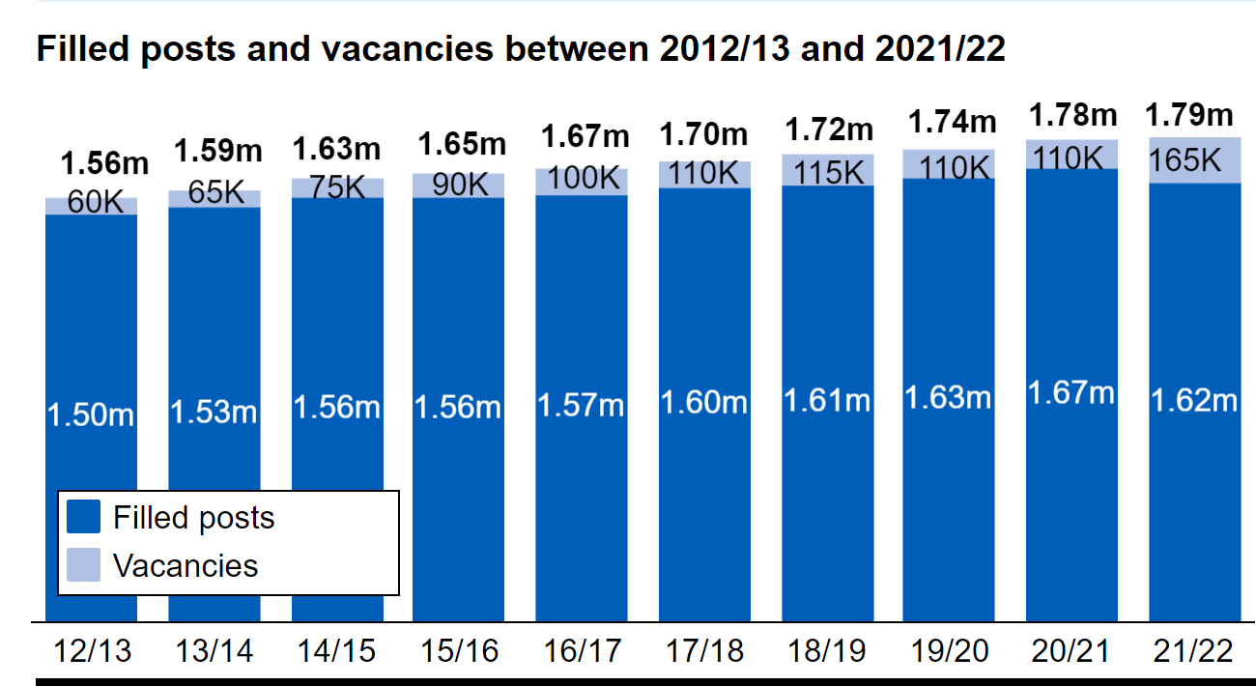
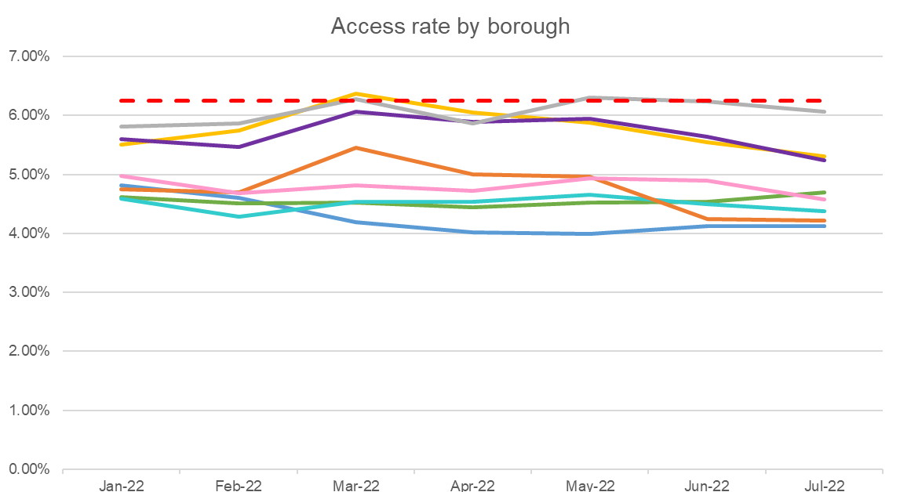
Challenges – health and care systems struggling to respond
Social care workforce
Access rate to mental health care

Slide 8
Residents - what residents in NW London communities are telling us
Inpatient services
Outpatient services
12% said they found it very easy to book an NHS appointment
Top 3 inpatient services*
Hospital planned surgery | 52%
Cancer services | 44%
Orthopaedic services | 42%
Top 3 Outpatient community services*
Ophthalmology services | 61%
Dental NHS services | 60%
Cancer services | 53%
Bottom 3 inpatient services*
Long terms conditions care | 48%
Mental health services | 45%
A&E inpatient | 40%
Bottom 3 Outpatient community services*
Mental health services | 51%
Long term conditions care | 39%
A&E outpatients | 37%
45% indicated that they found it very difficult to book an NHS appointment
81% indicated that they were treated equally by the NHS
19% indicated that they were not treated equally
Top 3 % = Very good and good combined ratings
Bottom 3 % = Very poor and poor combined ratings
~
Data from Citizen Panel (3.8k membership) ‘what matters to you’ survey
* Respondents were asked to pick their three top/ bottom inpatient and community services
Source: Citizens panel ‘what matters to you’ survey

Slide 9
Outcomes – how we’ve developed this draft framework
FOR COMMENT
Health and social care services in North West London will focus on the needs of the individual to promote their health and wellbeing, in particular to enable people to live healthier lives in their communities.
Reducing inequalities is a golden thread across everything that we all do in North West London.
The outcomes framework, drawn up by the Directors of Public Health and the Integrated Care Board,
Focuses on those areas where LAs and NHS working together can go further and faster in delivering for our residents (it is not intended to cover everything each partner is doing)
Starts from the Professor Marmot’s Fair Society, Health Lives (The Marmot Review)
Six areas in Fair Society, Healthy Lives
Give every child the best start in life
Enable all children, young people and adults to maximise their capabilities and have control over their lives
Create fair employment and good work for all
Ensure healthy standard of living for all
Create and develop healthy and sustainable places and communities
Strengthen the role and impact of ill health prevention

Slide 10
Framework – suggested outcomes against the health equity framework
FOR COMMENT
Give every child the best start in life
Identify inequalities by reviewing ethnic breakdown indicators, including:
Neonatal mortality and still birth rate
Smoking status at time of delivery
Vaccination uptake
Maternal mortality
Breastfeeding at 6-8wks post birth
B. Enable all children, young people and adults to maximise their capabilities and have control over their lives
Drug &Alcohol and substance misuse in under 18
Increased community participation rates. Reduction in mental health, problem drug use, offending and antisocial behaviour rates
Levels of overweight and obesity in CYP at Reception and Year 6
C. Create fair employment and good work for all
Gap in the employment rate between those with a physical or mental long- term health condition and the overall employment rate
Gap in the employment rate for adults known to MH services v overall adult population
Adult social care vacancy and retention rates below or equal to averages for benchmarking group of councils
F. Strengthen the role and impact of ill health prevention
Patients are referred to appropriate health promotion, support and education services:
Improve secondary prevention outcomes for patients with diabetes
NHS Health Checks
The rate of unplanned hospitalisations per 100,000 by neighbourhood by ethnic group
Admissions for alcohol related condition
Smoking prevalence
Proportion of people with mental health condition receiving a physical health check
Density of fast food outlets
Decayed missing or filled teeth in under 5s
D. Ensure healthy standard of living for all
Households in temporary accommodation
Food insecurity - percentage of households experiencing food insecurity
E. Create and develop healthy and sustainable places and communities
Reduced gradients in ill health associated with social isolation and adverse impacts of travel e.g. Pollution, and accidents
Focuses on those areas where LAs and NHS working together can go further and faster in delivering for our residents
Not intended to cover everything each partner is doing

Slide 11
Emerging headlines – with example priorities
WORK IN PROGRESS
Focus resource and differentiate the offer for groups experiencing poor outcomes, for example Black women and childbirth
Build confidence in our communities to come forward for care and support
Improve access to employment in the health and care system for our residents
Utilise the strength of borough based partnerships to focus on the wider determinants and inequalities
Support health and well-being
Address inequalities
Improve access
Rationalise channels for simple urgent care and streamline access
Develop/ roll out Integrated neighbourhood teams to bring community mental health, primary community and social care
Ongoing community and resident involvement
Identify people who have an ongoing health or care need, with a care plan in place, to ensure they receive continuity of care and as much treatment as feasible in their place of residence
Work with social care to develop the integrated health and care approach to avoid hospital and care home admissions and support patients moving from hospital to home care
Deliver care closer to home
Productive and high quality
Continue to develop innovative and cost effective models of care, starting with cardiovascular, cancer and children’s mental health
Develop workforce transformation plans
Ensure that our estate is fit for purpose
Happy, healthy
lives for children and young people
Develop consistent, ‘right person first time’ core models of care for children and young people
Expand access to mental health support

Slide 12
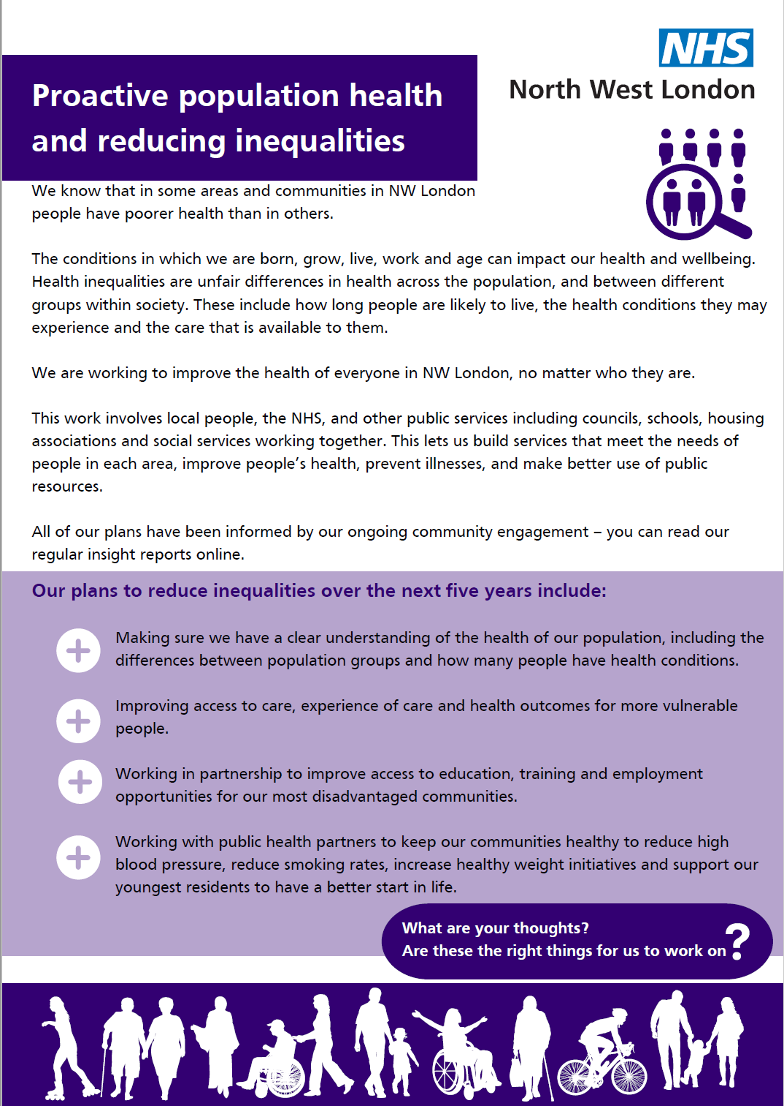
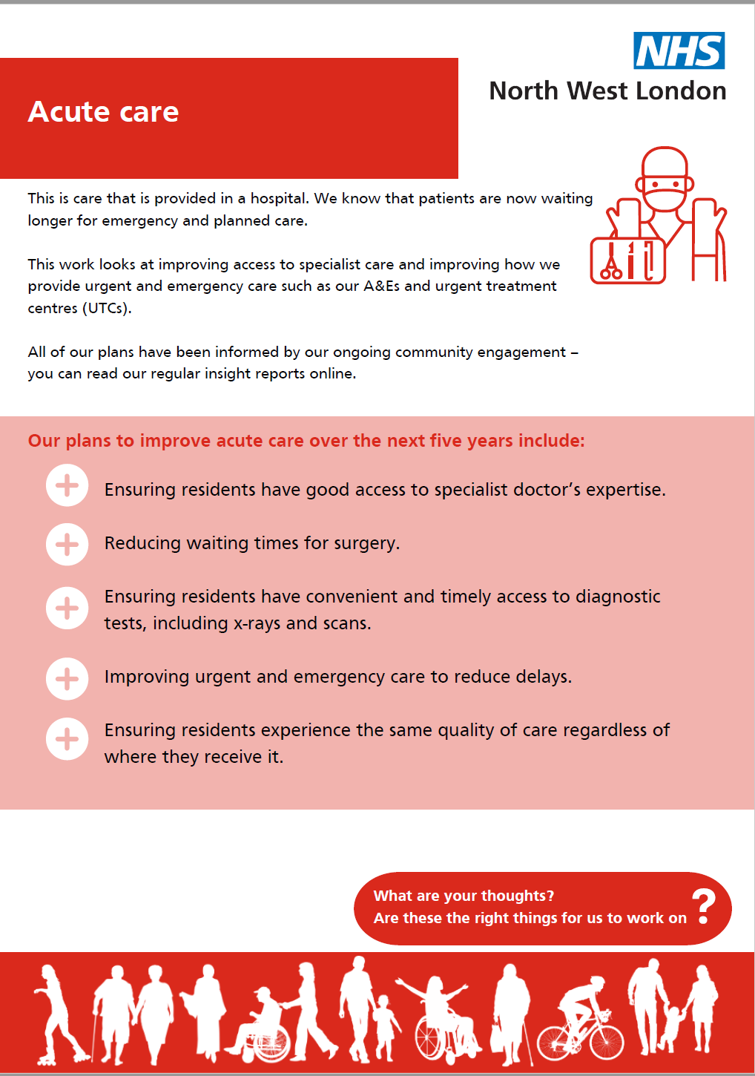
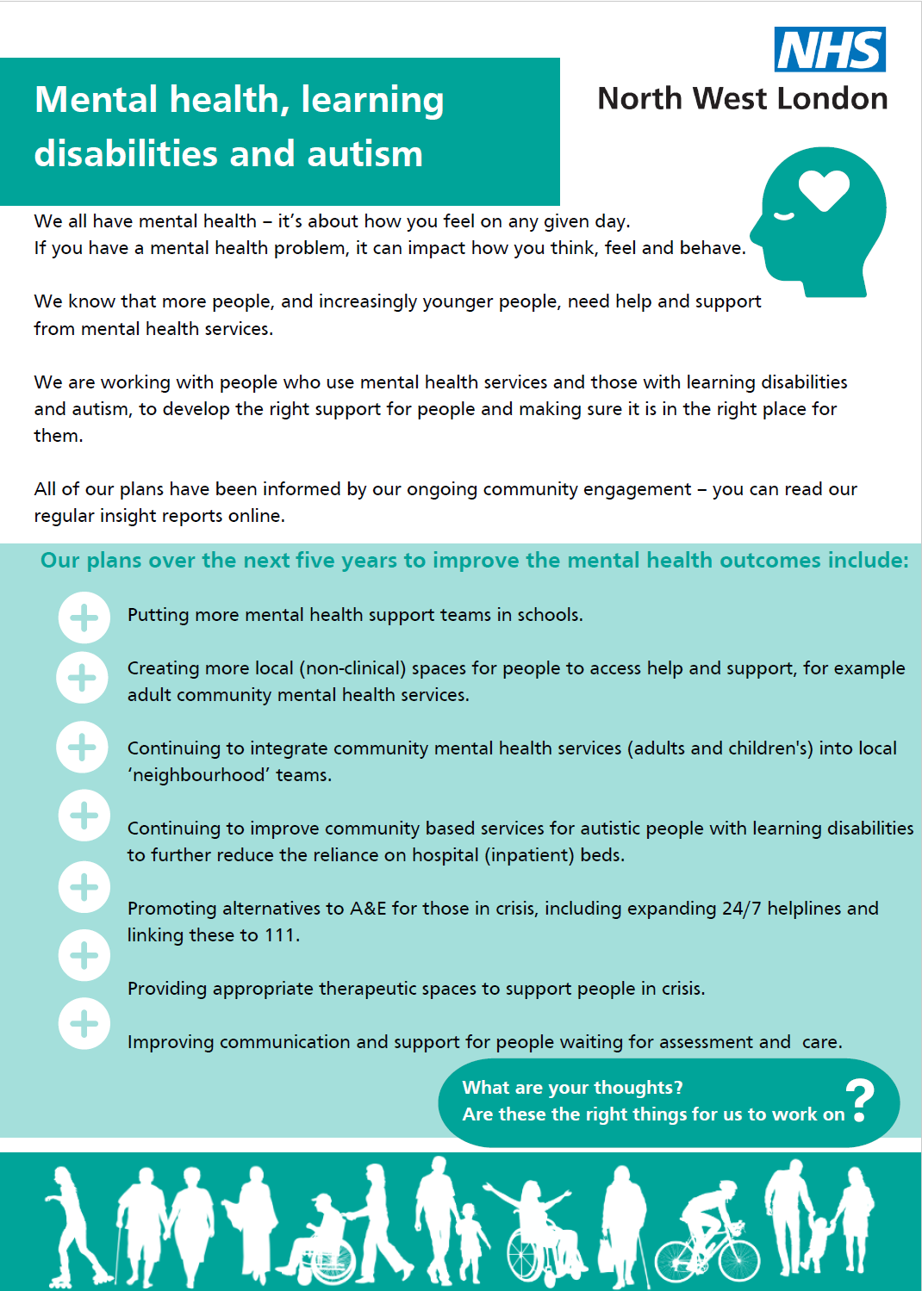
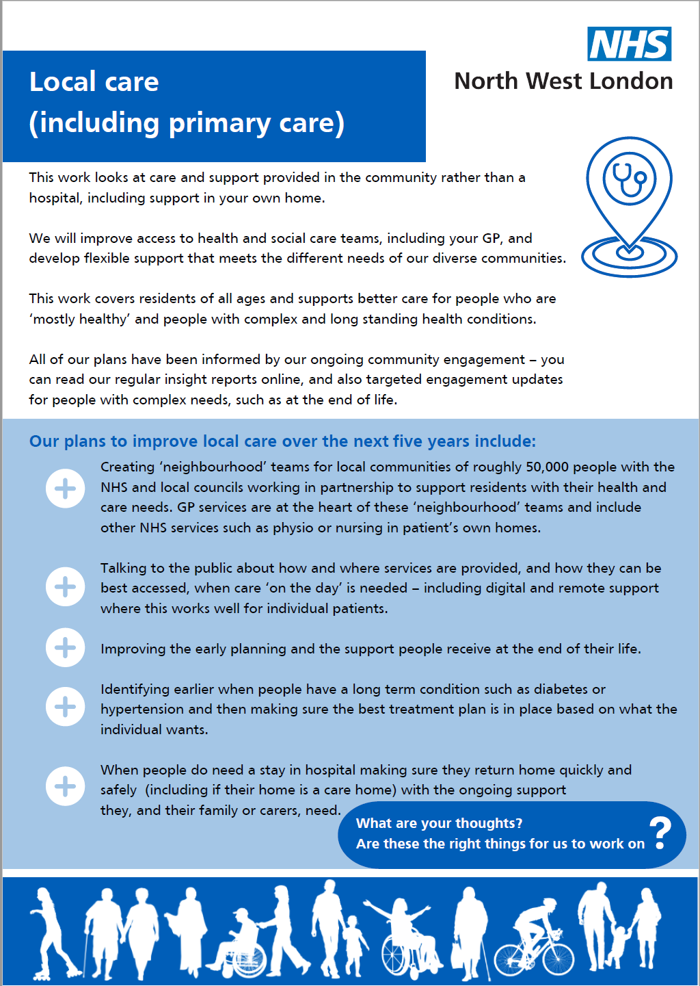
Engagement – the one page summaries capture actions by programme
These are included in the papers circulated for the meeting, and available on the ICB’s website at: https://www.nwlondonicb.nhs.uk/about-us/nw-london-health-and-care-strategy

Slide 13
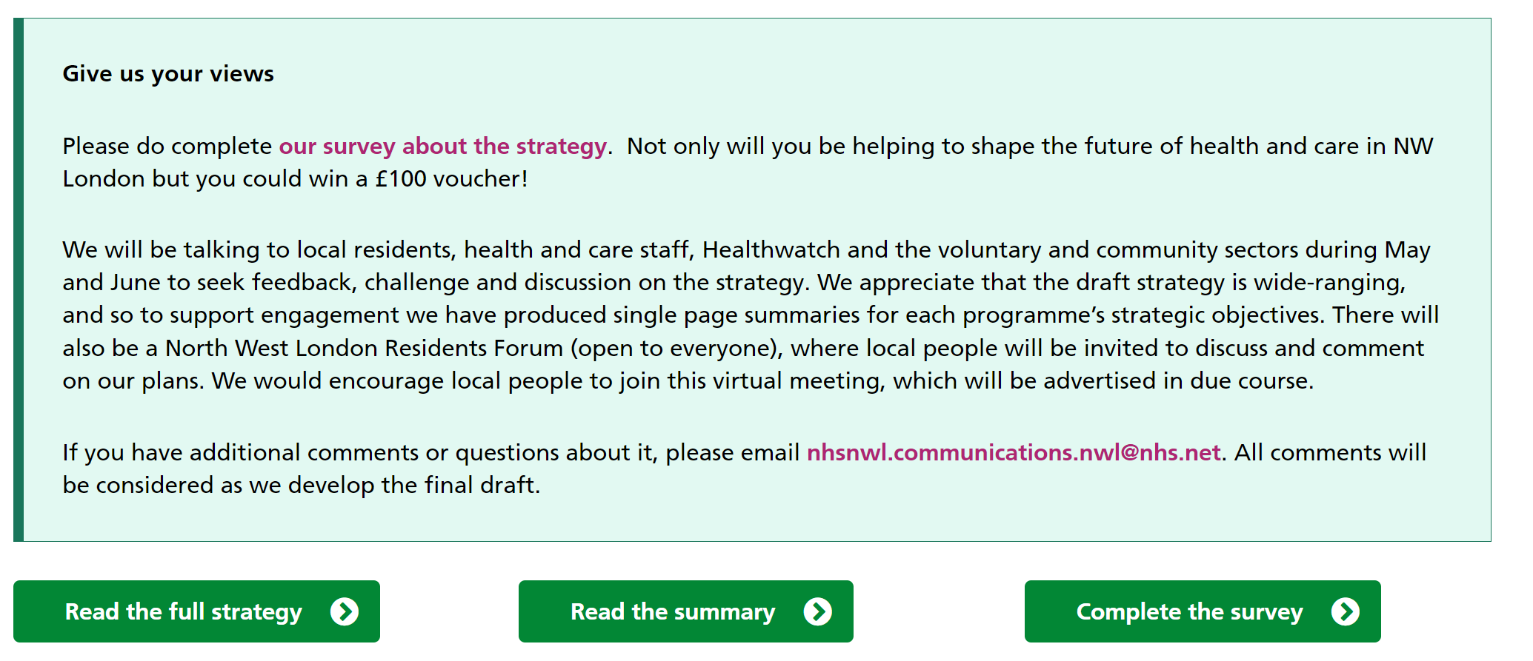
Feedback – Where you can read more and let us know your thoughts
Read more and feedback
www.nwlondonicb.nhs.uk/
about-us/nw-london-health-and-care-strategy
Contains:
Intro
Link to the summaries
Link to the easy read (coming soon)
Link to the full draft strategy
Link to a feedback form

